Slide 1

PHYS 365 & 369 Labs

Slide 2

Lab rules
Universal rule for ALL the labs!
http://www.webweaver.nu/clipart/food1.shtml

Slide 3
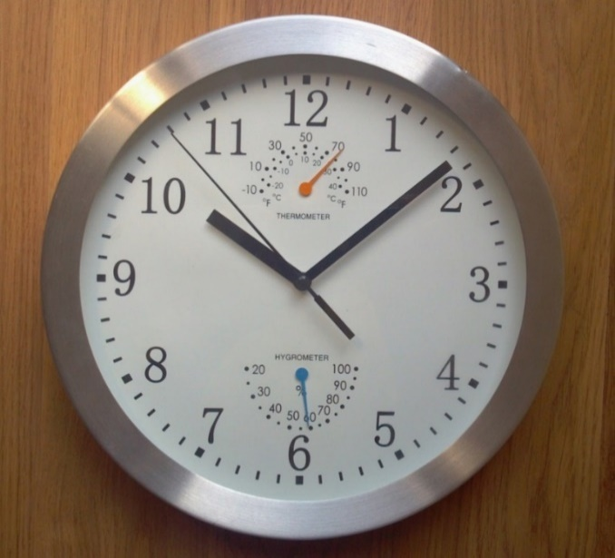
Lab rules
Come on time
  Up to 30 min late = -1.0 point (lab report)
  Over 30 min late = missed lab*
  If you are sick, you can not participate in the lab. Please notify your TA (email) and submit a “Missed Lab Request”
*if you have a legitimate excuse, fill-in and submit the form “Missed lab request” on D2L to the Missed Lab Dropbox

Slide 4
Lab D2L site
PHYS 365 LABS - (Fall 2025) – Acoustics, Optics, & Modern Physics
Contains:
  Lab write-ups
  Missed lab forms (to be uploaded to the D2L Dropbox within 5 business days of a missed lab)
  Pre-lab quizzes (individual submission before Monday at 8:00 AM of the week that you have the lab) and Dropboxes to submit Excel templates and lab reports (group submission 7 days after a lab has been completed)
  Grades
PHYS 369 LABS - (Fall 2025) – Acoustics, Optics, & Radiation

Slide 5
Group formation
Groups of three have been created on D2L.
These groups are labeled as PHYS 369 B01 - G 1 or PHYS 365 B01 - G 1.
Each group is linked to a specific Dropbox folder (Assessments/Dropbox). Please locate your lab section and then your group number.
Raw data and lab reports must be submitted there no later than one week after the lab.

Slide 6
Tips on working in groups
Everyone is responsible for your group success, make each member accountable from the very beginning
Find time to meet and discuss
Give yourself time to provide feedback prior to the lab report submission deadline
Find the best way to work together: TAs, instructors or coordinator will NOT be involved in your group dynamics

Slide 7
Form your groups now
Form your group of 3
Let your TA know who is in your group
Your TA will enroll you into your group on D2L
Once all groups have been formed and the enrollment process is completed, your TA will continue presenting the details of Lab 1

Slide 8
Lab 1: Uncertainty in the Pendulum

Slide 9
The purpose of this experiment is to find the best estimate of acceleration due to gravity, g, and to determine how accurately it can be estimated.
Examine Type A and Type B uncertainties as well as uncertainty propagation

Slide 10
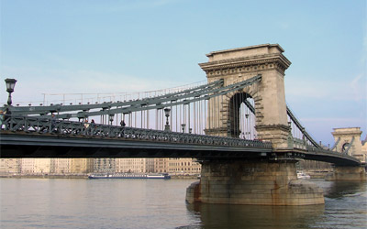
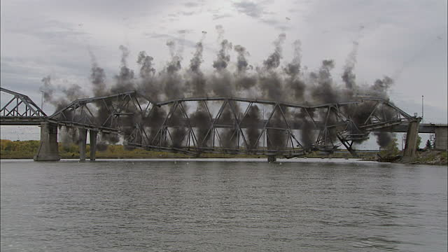
Why do we need uncertainties?
http://www.bridgesofbudapest.com/bridge/chain_bridge
http://www.gettyimages.ca/detail/video/steel-bridge-collapsing-into-river-and-birds-stock-video-footage/125522250
Notes:
Here you can see a safe bridge vs a steel bridge that collapses into the river!
“Part of a professional approach to engineering is understanding and quantifying uncertainty in your measurements.” (from measurement uncertainty document by Chris Cully)

Slide 11
Basic definitions
Measurement: a process by which a value of particular quantity is obtained
Value: a product of a number and the unit of the particular quantity
Through careful measurement we seek to ESTIMATE the true value of the quantity
Source: Les Kirkup and Bob Frenkel: An Introduction to the Uncertainty in Measurement

Slide 12
Uncertainty vs. Error
Error is the difference between the measured value and the ‘true value’ of the thing being measured.
Uncertainty is a quantification of the doubt about the measurement result.
Uncertainty is a positive number and has the SAME units as the measured value
http://www.wmo.int/pages/prog/gcos/documents/gruanmanuals/UK_NPL/mgpg11.pdf
Notes:
We do not know the true value, we are just estimating within uncertainty. The ‘true’ value of a measurement is the value that would be obtained by a perfect measurement, i.e. in an ideal world. As the true value is not known, accuracy is a qualitative term only.

Slide 13
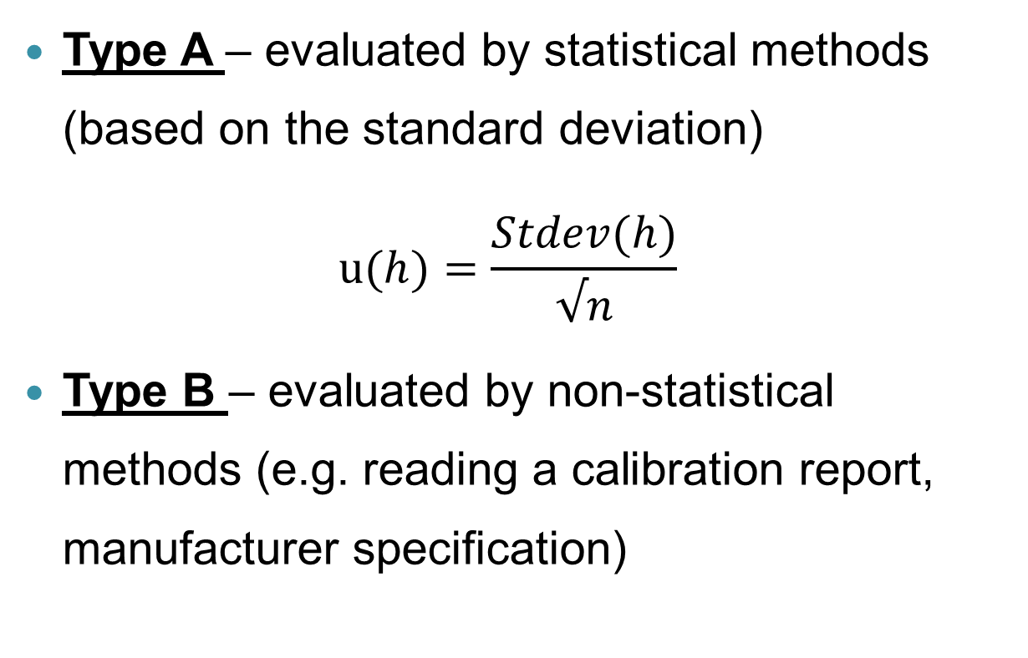
Two ways of evaluating standard uncertainty, u
Type A – evaluated by statistical methods (based on the standard deviation)
$$u(h)=\frac{Stdev(h)}{√n}$$
Type B – evaluated by non-statistical methods (e.g. reading a calibration report, manufacturer specification)

Slide 14
Propagation of uncertainties
When the final quantity (value) is calculated based on more than one measured quantity, uncertainties of all quantities are combined.
The uncertainty for the final value is called the combined standard uncertainty

Slide 15
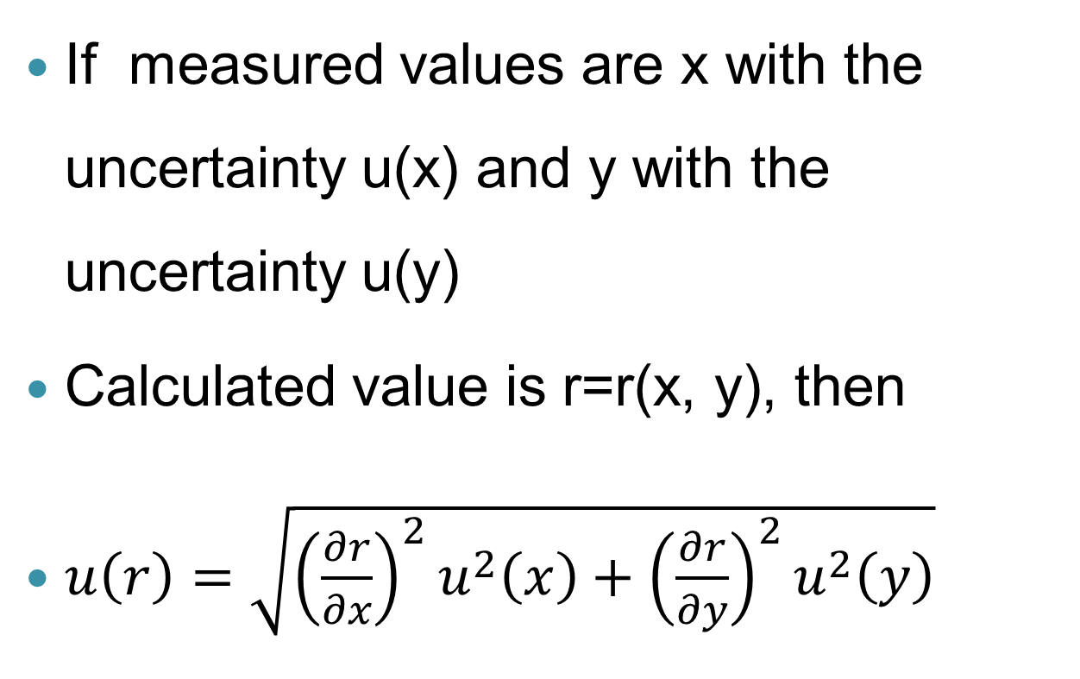
Combined standard uncertainty
If measured values are x with the uncertainty u(x) and y with the uncertainty u(y)
Calculated value is r=r(x, y), then
$u\left(r\right)=\sqrt{{\left(\frac{∂r}{∂x}\right)}^{2}u^{2}\left(x\right)+{\left(\frac{∂r}{∂y}\right)}^{2}u^{2}\left(y\right)}$

Slide 16
Reporting values and uncertainties
Procedure:
  Determine the value of interest, keeping all (or at least many) significant digits.
  Determine the uncertainty in the value, and round it to 1 significant digit.
  Write both the value and the uncertainty in the same units with the same magnitude (ie. If using scientific notation, use the same power of 10 for both).
  Round the value to the same number of decimal places as the uncertainty.
0.0012→0.001
9.8010→9.801

Slide 17
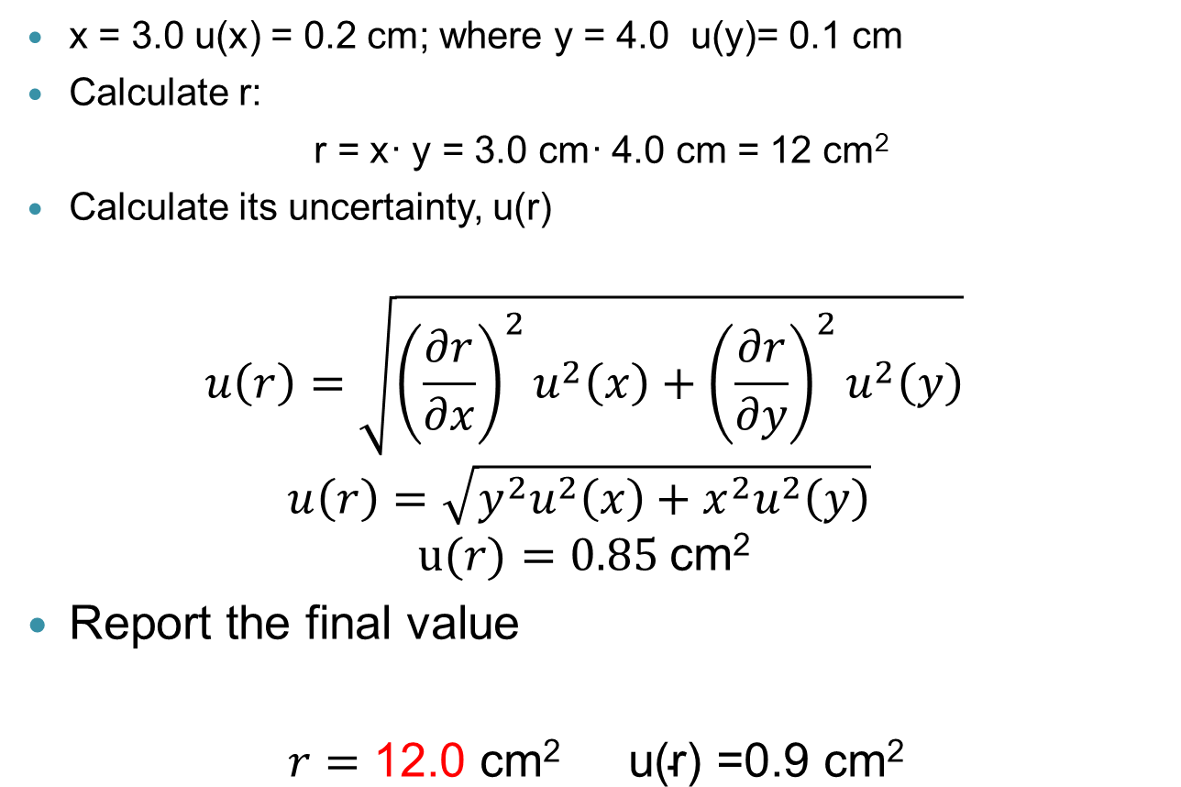
Example: Multiplication; r = x· y
x = 3.0 u(x) = 0.2 cm; where y = 4.0 u(y)= 0.1 cm
Calculate r:
r = x· y = 3.0 cm· 4.0 cm = 12 cm²
Calculate its uncertainty, u(r)
$$u\left(r\right)=\sqrt{{\left(\frac{∂r}{∂x}\right)}^{2}u^{2}\left(x\right)+{\left(\frac{∂r}{∂y}\right)}^{2}u^{2}\left(y\right)}$$
$$u\left(r\right)=\sqrt{y^{2}u^{2}\left(x\right)+x^{2}u^{2}\left(y\right)}$$
$$u(r)=0.85 \text{cm}\text{2}$$
Report the final value
$r=\text{12.0 }\text{cm}\text{2}$ $\text{u}\text{(}\text{r}\text{) =0.9 }\text{cm}\text{2}$

Slide 18
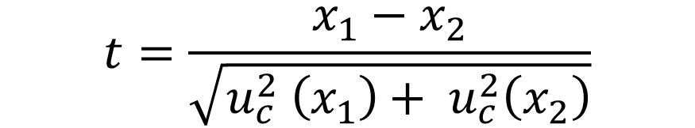
Comparing Two Values
What is the likelihood that x₁ and x₂ differ by at least the amount observed?
Small value of |t| means x₁ and x₂ are very similar
Large value of |t| means x₁ and x₂ are very dissimilar
$$t=\frac{x_{1}−x_{2}}{\sqrt{u_{c}^{2} \left(x_{1}\right)+ u_{c}^{2}\left(x_{2}\right)}}$$
For more information please see pages 9 & 10 of “Measurement Uncertainty” on D2L

Slide 19

Comparing Two Values
In the case of an “accepted value” such as a physical constant, we assume u(x₂) = 0 and the equation reduces to:
If |t| > 2 we say these values disagree
If |t| < 2 we say these values agree
$$t=\frac{x_{1}−x_{2}}{u_{c}\left(x_{1}\right)}$$
For more information please see pages 9 & 10 of “Measurement Uncertainty” on D2L

Slide 20
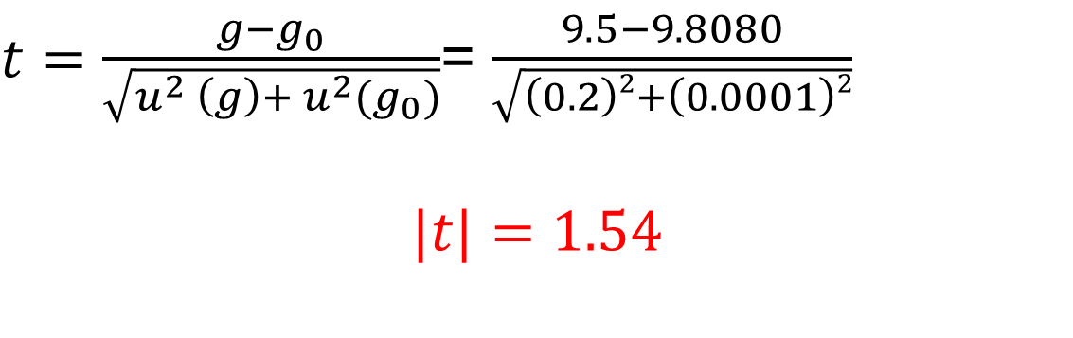
Comparing Two Values
For example, say we measure:
  g = 9.5 m/s² u(g) = 0.2 m/s²
  g₀ = 9.8080 m/s² u(g₀) = 0.0001 m/s²
  So we can say these values do agree
$t=\frac{g−g_{0}}{\sqrt{u^{2} \left(g\right)+ u^{2}(g_{0})}}$= $\frac{9.5−9.8080}{\sqrt{\left(0.2\right)2+\left(0.0001\right)2}}$
$$|t|=1.54$$
For more information please see pages 9 & 10 of “Measurement Uncertainty” on D2L

Slide 21
Lab 1 - Procedure
Determine a reasonable value for the uncertainty in your time measurement due to human reaction time.
Measure you pendulum length
Measure a single oscillation (Method 1)
Measure a single oscillation multiple times (Method 2)
Measure multiple oscillations (Method 3)
Vary the length of the string and measure multiple oscillations (Method 4)
Estimate the uncertainty in EACH CASE
Notes:
For human reaction time: use the template provided in D2L(TA folders), enter recorded times for the whole class and it will give you standard deviation and uncertainty. Display it on the screen.

Slide 22
Lab 1 – Plotting your results
On D2L you will find a Line Fitting Template containing two tools (under Templates):
  LINEST
    Type A uncertainties
    Uses least-squares fitting
    Assumes the same uncertainty for all points
  Fit with Uncertainty
    Type A and Type B uncertainties
    Different uncertainties for different points
For more info see “Measurement Uncertainty” document on D2L
Notes:
We are going to plot the results for 4th method(pendulum with various lengths). In the template there are 2 sheets: LINEST & Fit with Uncertainty and we should select which one to use

Slide 23
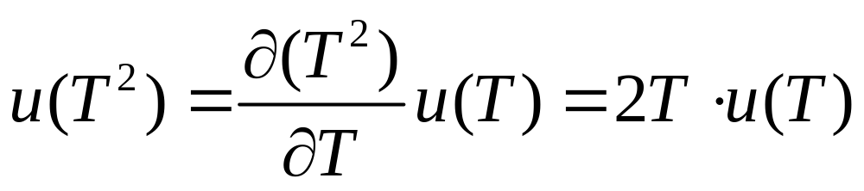
Lab 1 – Plotting your results
So which one should we use? Consider our responding variable, T²:
T is not constant, (we are changing the string length so the period should change also) so u(T²) is not constant
So, use the “Fit with Uncertainty”

Slide 24
Before you leave
Submit your raw data to the Dropbox!
(Must be submitted within 1 hour of lab completion)

Slide 25
Preparing your lab report
Use a word editor (no written by hand reports)
  You may use AI tools to help prepare your lab report, but you must ensure that it is consistent with the notation and approaches used in this course
  Keep it CLEAR & SHORT
  Example report available on D2L

Slide 26
Lab reports due date
Final Laboratory reports are due at 11:59 p.m., one week after the date of lab completion
There should be one report per group submitted to a Dropbox on D2L
  You can resubmit the report before the deadline but only the most recent submission will be graded
Submit as a PDF file only

Slide 27
For TAs:
Please enter attendance mark at the same day as the lab session(1-attended, 0-not attended). If a student was late(within 20 min) deduct 1 mark from his/her lab report.
At the beginning ask them to log into D2L and enroll the group individually. If they had any mistake there, you have access to modify it through your D2L.
To mark lab reports we should be consistent. Please follow the rubric carefully, add detailed comments where you deduct mark, no deduction less than 0.25!
For instance:
u(g) = 2.7186 m/s2.
TA comment: (-0.25,You should round these properly when you present the final answer)

